Slide 1
Unnatural Language Processing
Ritam Chattopadhyay

Slide 2
Problem Motivation
Collecting these datasets can be the most challenging part of the development process.
Leveraging the concept of “simulation-to-real" transfer in language understanding problems, making it possible to develop models that can interpret natural utterances without natural training data.

Slide 3
Approach
Instead of generating Natural language data from synthetic data, the authors propose to “project” natural language data on synthetic data produced by some pre-defined grammar (problem specific).
This enables the models trained on only synthetic data, to be robust to any natural language data.
Methods: seq2seq (baseline), seq2seq+BERT, LSH, Hierarchical.

Slide 4
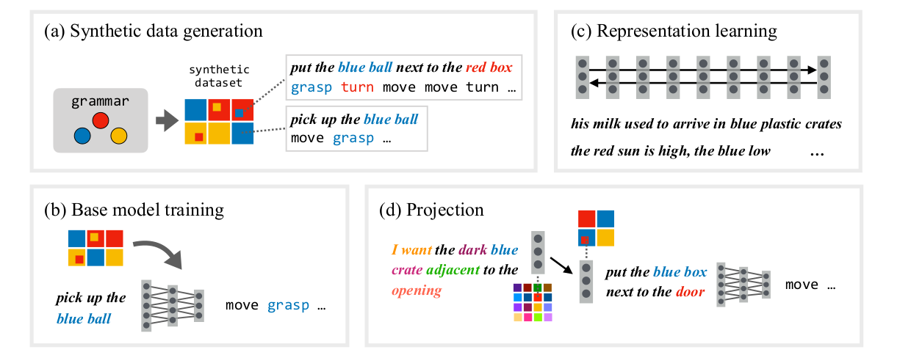

Slide 5

Methods
Locality sensitive hashing based projection (SimHash)
h(x) = [sign(l1.embed(x)) sign(l2.embed(x)).... sign(ln.embed(x))]
embed(x) = sentence embedding ( mean embeddings from BERT )
{l1 … ln} = Hyperplanes
Input sentences with same h(x) (fingerprints) are hashed to the same bucket.
Given a natural language input, we find the synthetic embedding such that:
Popular choice of delta : 1 - cos(ø), ø = angle between embed(x) and embed(x~)

Slide 6
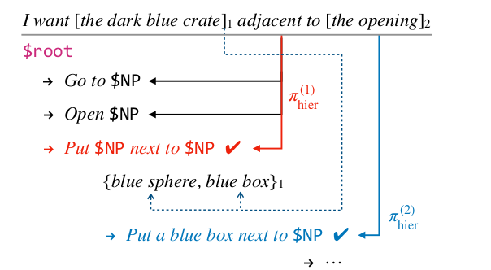
Methods (contd.)
2. Hierarchical Projection
Synthetic data generation follows CFG.
Locate the Noun Phrases from the
natural language input.
Hierarchically generate synthetic sentence,
using the grammar , with maximum
similarity.

Slide 7
My Approach
The paper mainly mentions the use of BERT embeddings.
I tried out with other embeddings, such as GloVe, in Locality Sensitive Hashing procedure.
Used DME in instead of BERT embeddings in seq2seq model, which gave better Exact_Match score.

Slide 8
Experiments and Results
Overnight data set results:
Model | Publications domain | Social media domain
seq2seq | 43/161 | 196/843
seq2seq+BERT | 33/161 | 201/843
LSH | 7/161 | 34/843
seq2seq+DME | 51/161 | 267/843
LSH+GloVe | 10/161 | 46/843
Hierarchical | 48/161 | 238/843

